Slide 1

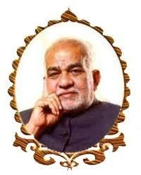
BVRIT HYDERABAD
College of Engineering for Women
Department of Computer Science and Engineering
A Deep Learning based System for Landmark and tourist place recognition
Under the Guidance of:
Name: Ms. S.Vidyullatha
Designation: Assistant Professor
Team No: C_5
19WH1A05G1- G.Varsha Priya
19WH1A05F0 - S. Meghana
20WH5A0517 - S. Malavika

Slide 2
AGENDA
Introduction
Existing system
Problem statement
Proposed system
Tools and Technology
Societal impact
Project timeline
References

Slide 3
INTRODUCTION
More and more information about tourist attractions is being portrayed visually rather than textually.
As a result, tourists who are interested in a specific attraction represented in photographs may not know how to conduct a text search to learn more about the intriguing tourist places.
In light of this issue, and in order to improve the tourism industry's competitiveness, this study proposes an innovative tourist spot identification mechanism based on deep learning-based object detection technology for real-time detection and identification of tourist spots by taking pictures on location or retrieving images from the Internet.

Slide 4
EXISTING SYSTEM
Currently most of the searches are about tourist are done using Text. Although there are several instances where text information is not available and or is not enough.
There are several Image based system which can identify tourist spots using Images which uses algorithms like SVM which are not accurate and are not well suited.

Slide 5
DISADVANTAGES OF EXISTING SYSTEM
Support vector machine algorithm is not acceptable for large data sets.
It does not execute very well when the data set has more sound i.e. target classes are overlapping.
In cases where the number of properties for each data point outstrips the number of training data specimens, the support vector machine will underperform.

Slide 6
PROBLEM STATEMENT
This project creates a tourist spot recognition system, which is a Deep Learning AI framework that is used to identify tourist destinations by providing photographs and Images.

Slide 7
PROPOSED SYSTEM
We propose a Advance Deep Learning System which will be able to detect the Name and Details about a Tourist Spot just by using the Image provided. Currently the System will be trained to recognize some major Tourist Spots with a Web App based intuitive Interface.

Slide 8
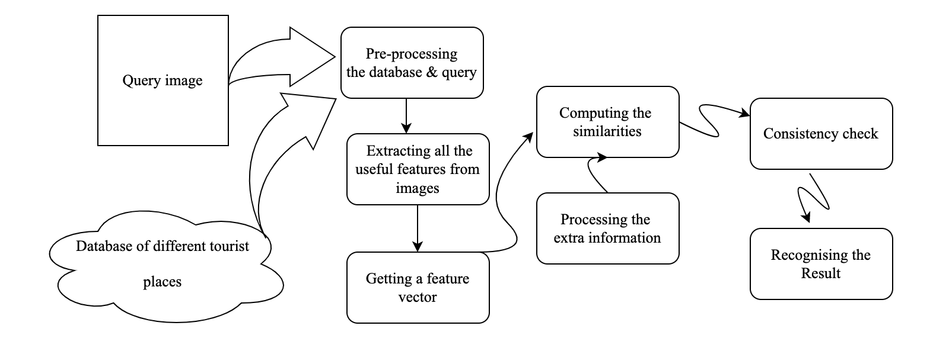
PROPOSED SYSTEM FLOW CHART

Slide 9
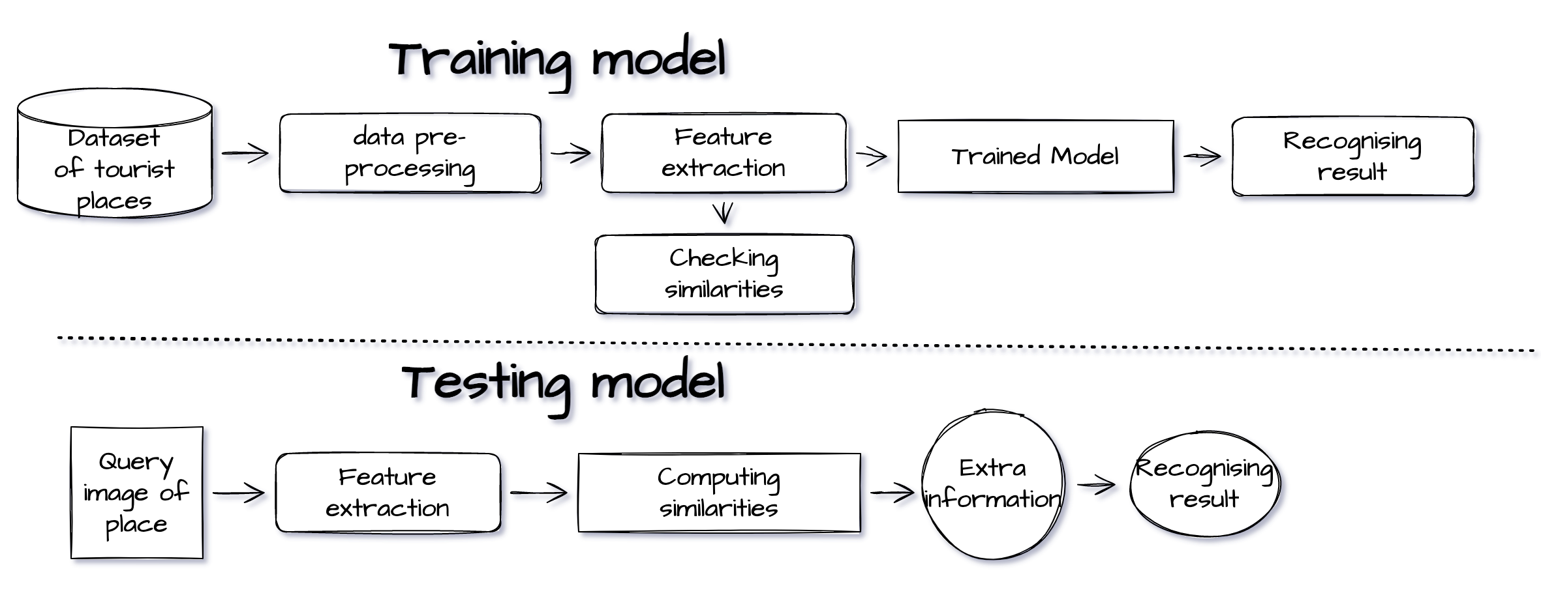
PROPOSED SYSTEM WORKFLOW

Slide 10
DATA SET
Source: Dataset contains tourist spot images
Number of Images: 30000
Number of Classes: 30
CSV File: .csv file contains information about the classes

Slide 11
METHODOLOGY
Deep residual networks like the popular ResNet-50 model is a convolutional neural network (CNN) that is 50 layers deep. A Residual Neural Network (ResNet) is an ANN of a kind that stacks residual blocks on top of each other to form a network.

Slide 12
Modules
Tensorflow
Keras
OpenCV
Sklearn
CUDA

Slide 13
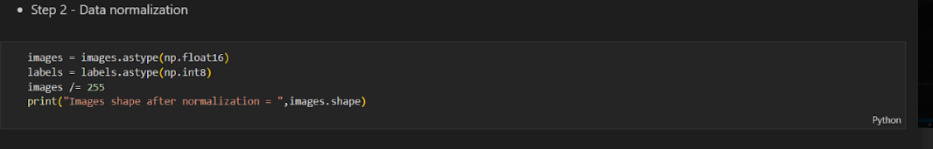
Data Normalization

Slide 14
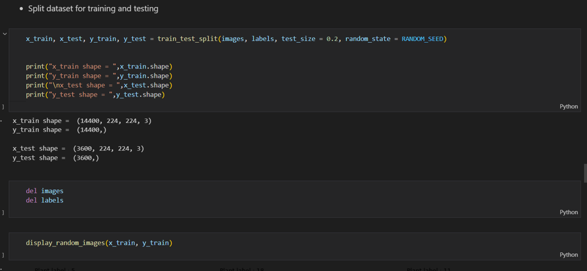
Splitting Dataset for testing and training

Slide 15
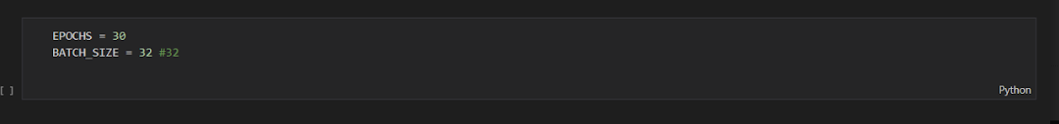
Epochs and Batch Size

Slide 16
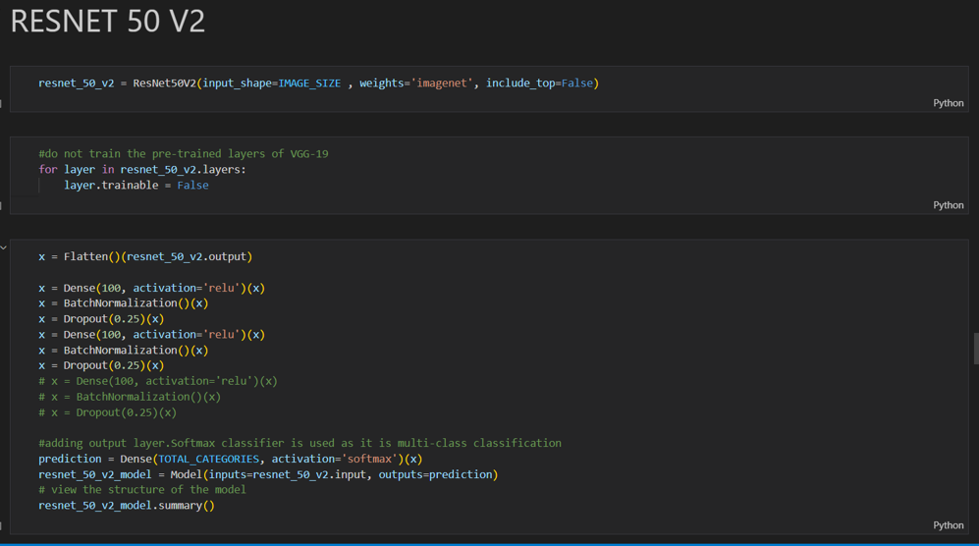
Initializing the Resnet-50 V2 model

Slide 17
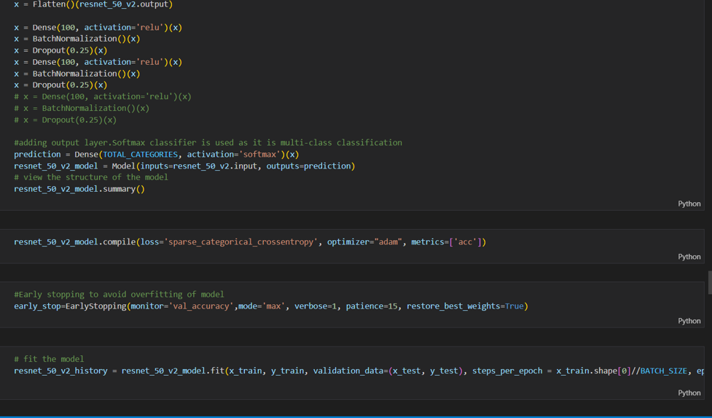
Continued…

Slide 18
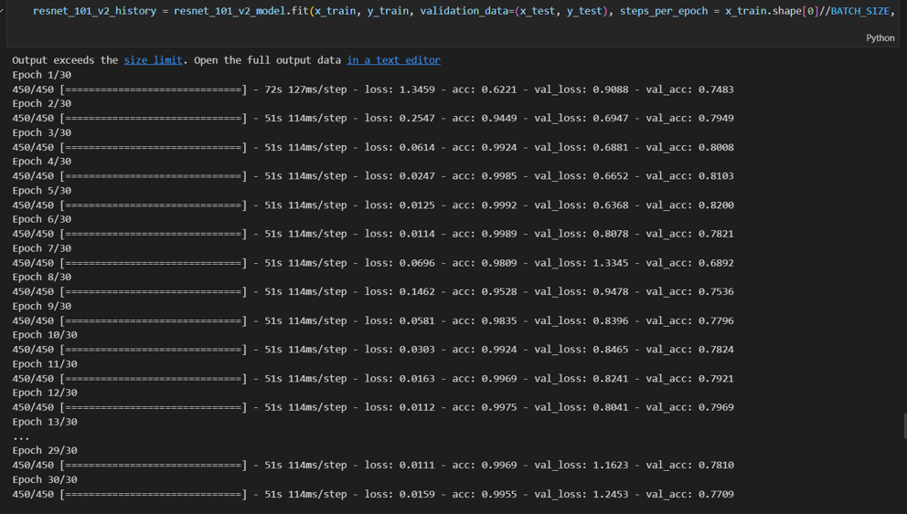
Training the Model

Slide 19
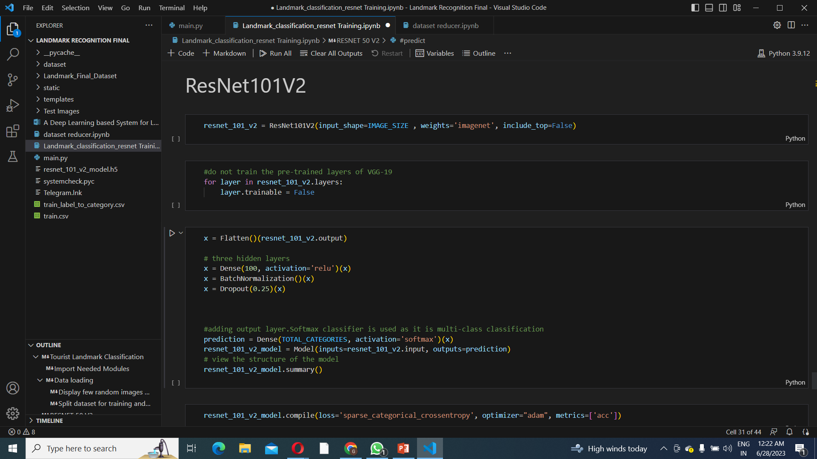
Initializing the Resnet-101 V2 model

Slide 20
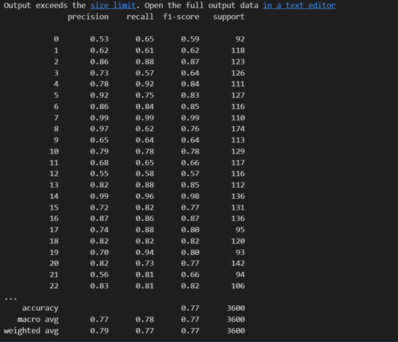
Evaluation Metrics

Slide 21
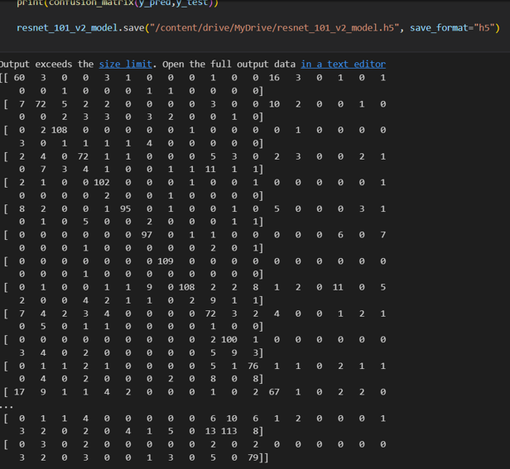
Confusion Matrix

Slide 22
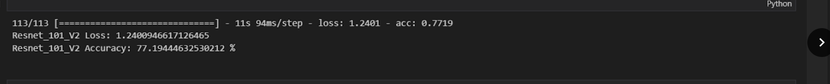
Model Evaluation

Slide 23
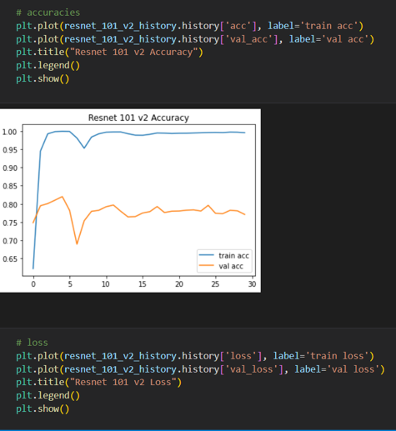
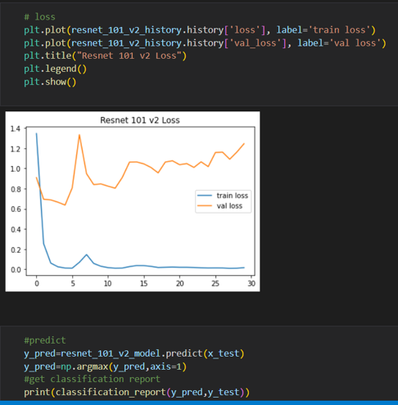
Model Accuracy and Loss

Slide 24
Result
Proposed Model Accuracy:
Model 1:
Resnet 50-v2 = 71.07%
Model 2:
Resnet 101-v2 = 77.1 %

Slide 25
TECHNOLOGY STACK
HARDWARE REQUIREMENTS
Processor: i5 10th Gen or better
RAM: 8GB or better
Storage: 120GB or more
SOFTWARE REQUIREMENTS
Windows 10
Python 3.6 or newer
Necessary Python Modules

Slide 26
SOCIETAL IMPACT
Now a days more and more information about tourist attractions is being portrayed visually rather than textually. As a result, tourists who are interested in a specific attraction represented in photographs may not know how to conduct a text search to learn more about the intriguing tourist places.
In light of this issue, and in order to improve the tourism industry's competitiveness, this study proposes an innovative tourist spot identification mechanism based on deep learning-based object detection technology for real-time detection and identification of tourist spots by taking pictures on location or retrieving images from the Internet.

Slide 27
Feasibility Study
TECHNICAL STUDY:
Dataset is trained using Resnet50v2 model and Resnet101v2 which need to be supported by system which has > i3 processor and graphics card.
Flask frame work is used for deploying model and showing prediction
OPERATIONAL STUDY:
User friendly interface to interact with user to predict result.
Prediction time will be reduced.

Slide 28
PROJECT TIMELINE
Date | Duration | Task
25 - 09 - 2022 | 1 week | Introduction/ Abstract Specifications Literature Survey References
19 - 11 - 2022 | 6 weeks | Finding out suitable algorithm. Data Set Selection. Literature Survey
22 – 12 - 2022 | 4 weeks | Literature Survey Dataset Collection Segregating dataset into respective classes Pre-processing the dataset Splitting the dataset into testing and training modules

Slide 29
Project Timeline Contd..
16-03-2023 | 5 weeks | Training the model Modifying different input parameters for improving accuracy Tried different epochs number and batch size
 |  | Severity prediction Paper publishing

Slide 30
REFERENCES
[1] Szegedy, C., Vanhoucke, V., Ioffe, S., Shlens, J. and Wojna, Z., 2016. Rethinking the inception architecture for computer vision. In Proceedings of the IEEE conference on computer vision and pattern recognition (pp. 2818-2826).
[2] Szeliski, R., 2010. Computer vision: algorithms and applications. Springer Science & Business Media.
[3] Umbaugh, S.E., 2010. Digital image processing and analysis: human and computer vision applications with CVIPtools. CRC press.
[4] Alsing, O., 2018. Mobile object detection using tensorflow lite and transfer learning.
[5] Gada, S., Mehta, V., Kanchan, K., Jain, C. and Raut, P., 2017, December. Monument recognition using deep neural networks. In 2017 IEEE International Conference on Computational Intelligence and Computing Research (ICCIC)

Slide 31
THANK YOU

